Slide 1
Penalty Timecards
Purpose, instructions, reasons and effects

Slide 2
There are times that the carrier violates the agreement between NJ Transit and SMART-TD that results in a member submitting a timecard for payment. This process is contained in Rule No. 42 of the current agreement. To highlight this agreement, here are some points to keep in mind.
A member has thirty (30) days from the date of the occurrence on which the claim is based, to submit the claim. If the claimant is absent because of sickness, temporary disability, leave of absence, vacation or suspension the time limits shall be extended by the number of days the claimant is absent.

Slide 3
The claim must include all the information concerning the claim such as:
Name, occupation, employee number, division.
Train symbol or job number.
On and off duty time.
Date and time of day work was performed.
Location and details of work preformed for which claim is filed
Upon whose orders work was performed.
Description of instruction issued to have such work performed.
Claim being made, rule violation, and all related information for supporting claim.
Location on the property for receipt of response.
The Claim shall be filed with the original and a duplicate copy. The claim timecard will be signed by you and dated by the company representative (ticket receiver clerks), and a copy returned to the claimant for his/her records. Locations where the claim can be submitted to the carrier are listed in the carrier’s TRO-12, under penalty claims.
The carrier has up to sixty (60) days from the date the claim is submitted to either pay or deny the claim. UTU members receive the denials on their payroll printout.
If the claim is denied, the claimant must provide a copy of the timecard and the denial report to the Union office. If additional information concerning the facts surrounding the claim can be provided, the claimant should also include this. The Union will then prepare an appeal to the carrier. The appeal must be filed within sixty (60) days from the date the denial is received.

Slide 4
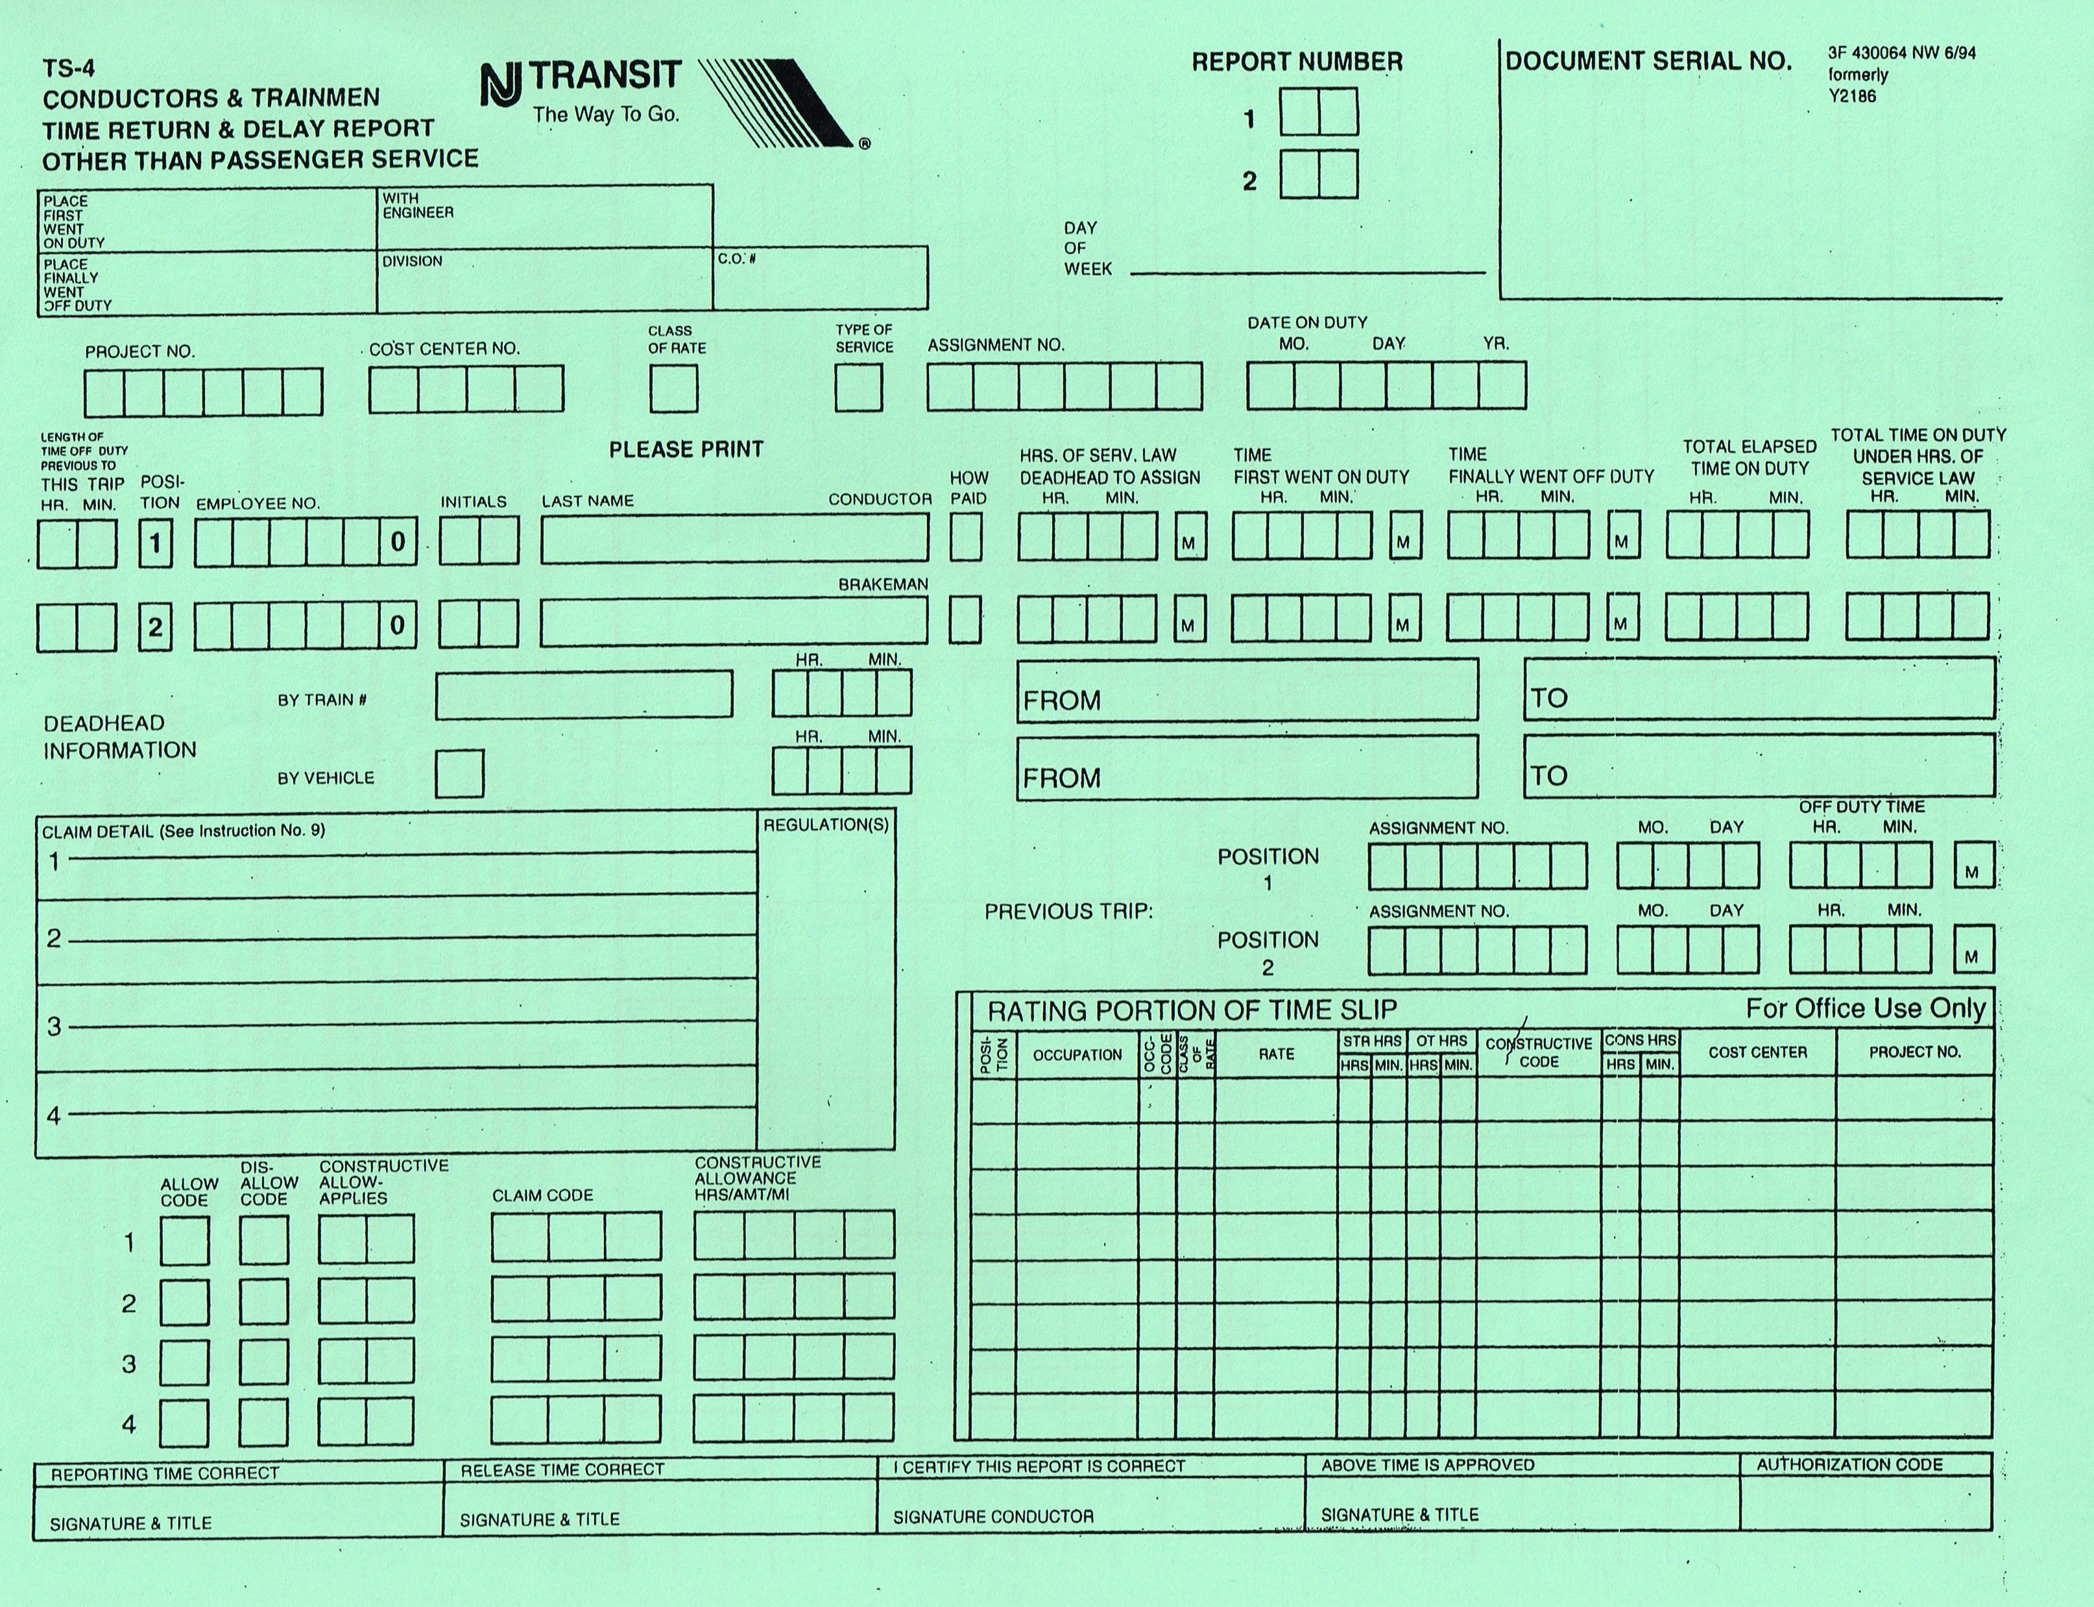
PENALTY
WOODBINE
Sunday
WOODBINE
HOBOKEN
S V - 9 0
0 2 2 8 2 1
0 8 0 8 6 0
S F SPRATT
Pay eight-hour penalty for violation of Rule 17 letter A I was not notified my assignment was abolished until 10:00pm on 12/28/21 less than the 24-hour required by rule nor was information contained in BO or LC notified

Slide 5
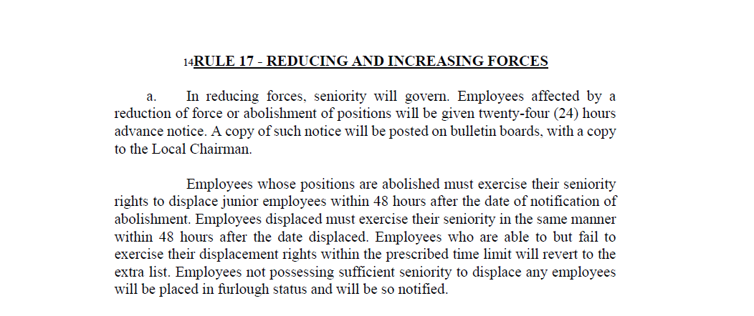

Slide 6
Submitting penalty claims
Fill out your timecard as instructed, include all information possible use the back of timecard if necessary
Bring timecard to a ticket receiver and have timecard stamped in top right-hand corner
They will make a copy of timecard and give the copy back to you (they keep the original)
Once you receive a denial get a copy of timecard and denial to local 60 office (retain originals) use provided boxes in HB or NY, hand to an officer, mail to office (address is on local 60 site)

Slide 7
penalties, what is next step
There are on occasion different interpretations of the agreement between the carrier and organization
When resolution can not be reached between local supervision or labor relations a penalty timecard is necessary
These are more often than not denied by the verification department
Claims are then discussed between labor relations and the GC and or LC

Slide 8
penalties, what is next step
Claims are negotiated and sometimes agreed to, these can be for full amount claimed (lost earnings) or for an agreed upon amount, pay 4 hours for an 8-hour claim
This is dependent on the type and number of claims received.
Claims that are not settled will be brought before an arbitrator from the NLRB
Claims pursued to be brought before an arbitrator will sometimes never be heard because more serious claims go first i.e., dismissals, suspensions
Selection is completely random and not selected by either party

Slide 9
penalties, what is next step
Some claims affect many members, and the organization will write these up as a group with the hope that they are selected to be heard by an arbitrator i.e.; Rule 25 the organizations position is that this is past practice and are payable as an 013 the carrier’s position is that with change in HOS regulation this is a new rule so not payable.

Slide 10
Successful Arbitrator awards
Rule 23 Q&A 101
Question 101 How will employees who are called and used to perform services in advance of their regular assignment and then revert to their regular assignment be compensated?
Answer Those employees shall be paid 8 hours straight time compensation pursuant to the provisions SBA 952 Award number 13.

Slide 12
penalties, where we are currently
Most denials will come from the verification department, this is on the bottom of your payroll advice
If you received a letter for a denial from labor relations that is because of the backlog of claims, verification was unable to handle so labor relations had to step in and process them, they sent letters out, it is the same as the denial on bottom of your advice (as a side note this is triggering penalty claims from the TCU because it’s a violation of their agreement)

Slide 13
penalties, where we are currently
We have a major backlog, and are meeting periodically with labor relations to work through claims, we have some as old as 2016, as these are resolved members will be notified via the local 60 office

Slide 14
penalties, where we are currently
Q & A

