Slide 1

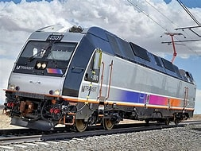
RAIL OPERATIONS
RAIL UNION RETIREES
OVER
AGE 65

Slide 2

ELIGIBILITY REQUIREMENTS
  NJ Transit Rail Operations Agreement Health Care Plan for employees aged 65 and over:
    Following 30 years of credited railroad service and or over age 65.
    BA6 form is required to prove an accumulation of 30 years of service with NJ Transit and other Railroad entities from the RRB.
    If the spouse/partner is over 65 at the time of retirement, he/she may enroll in NJ Transit’s Supplemental Plans.

Slide 3

Enrolling Legal Spouse
SPOUSE ELIGIBILITY REQUIREMENTS
Key Notes:
Retirees can add their legal spouse and child/children providing the supporting documents.
Employee and spouse must be married one year prior
to retirement date.
  Documentation required
    Marriage Certificate
    Birth Certificate for spouse and child(ren)
    Social Security Cards for spouse and child(ren)
    First Page of Federal Tax Form 1040 with financial information redacted/masked to add a spouse/partner*

Slide 4
COVERAGE TERMINATION
COVERAGE | ACTION | EFFECTIVE DATE
Medical | Terminate | End of the month following the month in which retirement occurs.
Dental | Terminate | End of the month following the month in which retirement occurs.
Prescription Drug Card | Terminate | End of the month following the month in which retirement occurs.
Vision | Terminate | End of the month following the month in which retirement occurs.
Supplemental Life | Transfer to Retiree amount | End of the month following the month in which retirement occurs.

Slide 5

RAIL UNION RETIREMENT BENEFITS
All Rail Union employees eligible are entitled to participate in the following Supplemental plans on the first of the month you become eligible for Medicare:
Supplemental Plans:
  Horizon Braven Medicare Plan
  Horizon Medicare Supplemental Plan
  Your spouse/partner may also participate in these plans on the first of the month he/she
  becomes eligible for Medicare.
  Life Insurance
  The Hartford Insurance Plan
      For retiree only
Enrollment in Medicare Parts A and B is required for retirees and/or their dependents on disability who are eligible for Railroad retirement.

Slide 6

Retirement Medical Plan Rates
Effective January 1, 2024 – RATES ARE SUBJECT TO CHANGE
MONTHLY RAIL UNION OVER 65 RATES
  Horizon Braven Medicare Plan
Horizon Medicare Supplemental Plan
RETIREE SINGLE
$257.43
RETIREE & SPOUSE/PARTNER
$514.86
  RETIREE SINGLE
$448.46
RETIREE & SPOUSE/PARTNER
$1,018.18
Enrollment in Medicare Parts A and B is required for retirees and/or their dependents on disability who are eligible for Railroad retirement to be eligible for plans.

Slide 7
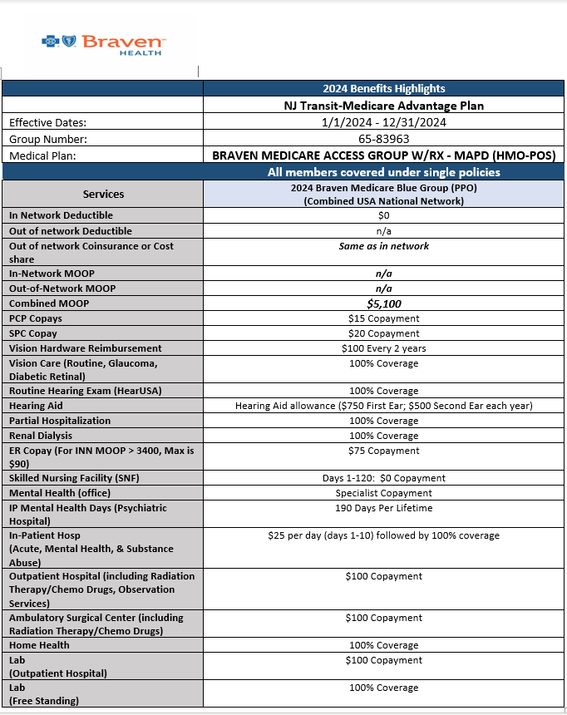
Horizon Braven Medicare Plan Summary
RETIREES 65+

Slide 8
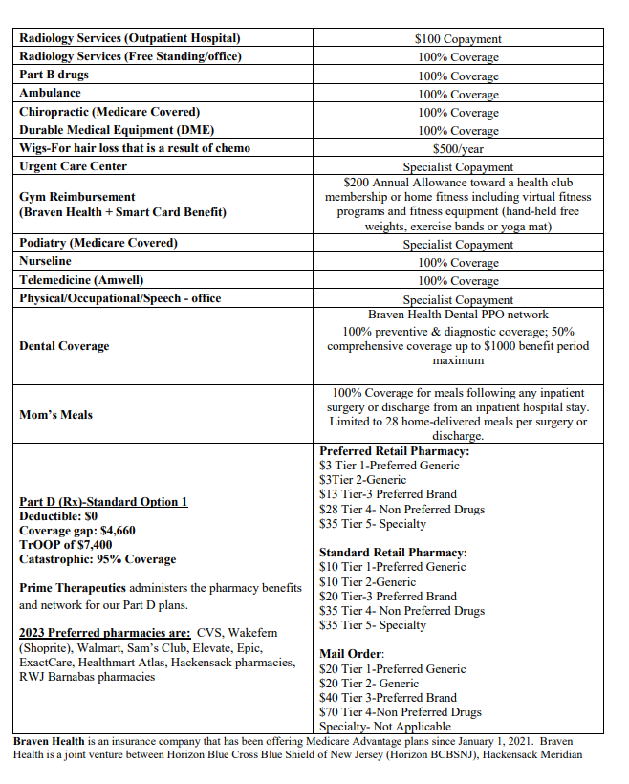
Braven Summary Cont.

Slide 9

PREFERRED RETAIL PHARMACIES
CVS, WAKEFERN (SHOPRITE)
ELEVATE, HEALTHMART ATLAS, EPIC
WALMART, SAM’S CLUB
HACKENSACK MERIDIAN
RWJ BARNABAS
MAIL ORDER PHARMACY
ALLANCE Rx WALGREENS PRIME
24 hours a day (7 days/wk)
WEB SITE: www.alliancerxwp.com
TELEPHONE NUMBER
(800) 391-1916
(TTY users:711)

Slide 10


BRAVEN
DENTAL PLAN Summary

Slide 11

Braven Dental Plan Breakdown

Slide 12
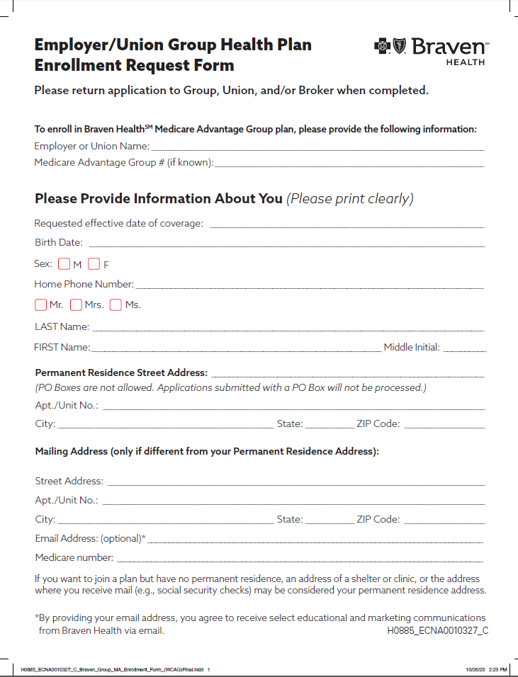
Braven Medicare Application
SAMPLE

Slide 13


MEDICARE SUPPLEMENTAL PLAN
ELIGIBILITY
  Retirees over or attain age 65 after retirement
  Qualifies for Pension under the Railroad Retirement Board
  Must enroll in Medicare Part A and Part B
This Photo by Unknown Author is licensed under CC BY

Slide 14
MEDICARE SUPPLEMENTAL PLAN BREAKDOWN
PLAN COVERS
Deductible | $50.00 per individual calendar year
Major Medical (Doctors charges, labs, x-rays, etc.) | Plan pays after Medicare payment
Inpatient Hospital | Medicare Hospital Deductible
Radiation Therapy | Plan pays charges after Medicare payment
Physical Therapy | Plan pays charges after Medicare payment
Durable medical Equipment | Plan pays charges after Medicare payment
Emergency Room-Medical Emergency | Plan pays charges after Medicare payment
Maximum Lifetime Benefit | None

Slide 15


SUPPLEMENTAL INSURANCE
PRESCRIPTION DRUG PLAN
OVER AGE 65
PAY FULL COST OF MEDICATION AT RETAIL PHARMACY
RECEIVE 80% REIMBURSEMENT FROM HORIZON
SUBMIT THE HORIZON CLAIM FORM TO THE ADDRESS LOCATED ON TOP OF THE CLAIM FORM
RECEIVE REIMBURSEMENT CHECK IN THE MAIL

Slide 16
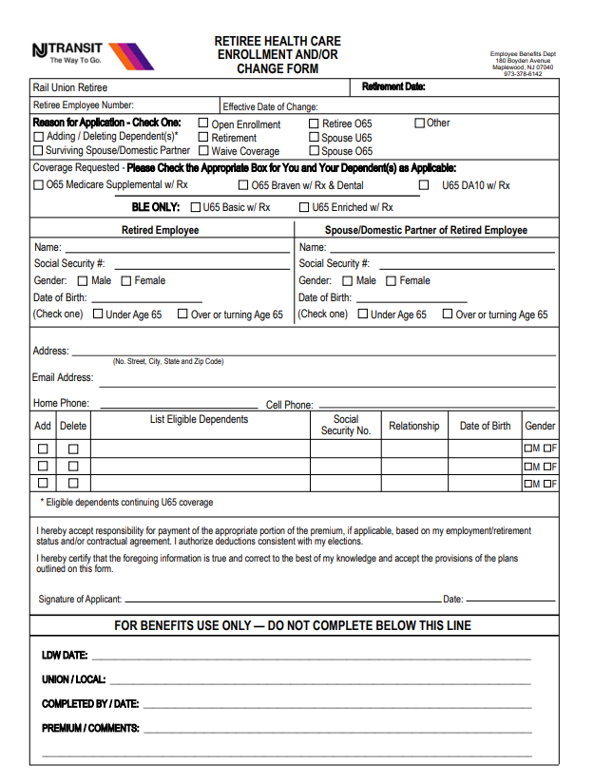
Supplemental Enrollment Form
Reason for application
Select the box that applies to you/dependent
SAMPLE
Employee personal information
Spouse personal information
If you would like to add a dependent, fill out this portion and provide all supporting documentation.
Sign and Date

Slide 17


LIFE INSURANCE
Hartford Life Insurance Company
PLAN
Conversion Available – Call (877) 320-0484 | May convert active Hartford Life Insurance policy within 90 days after retirement date: ($5,000.00, $8,000.00, $25,000.00 or $50,000.00)
Basic Life Insurance Reduction from $10,000.00 | $2,000.00 Free

Slide 18

Congrats on your Retirement!!
Here are some
Important Phone Numbers
Contact | Phone | Email & Website
Shonta Thomas Assistant Manager Rail Retiree Benefits | P: 973-378-6035 F: 201-992-9307 | SRThomas@njtransit.com
Horizon BCBSNJ Member Services Medical | 877-241-8414 | www.horizonblue.com/njtransit
The Hartford | 877 320-0484 | www.thehartford.com
t

