Slide 1

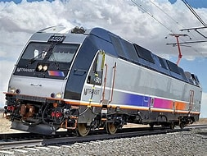
RAIL OPERATIONS
RAIL UNION RETIREES
Under
Age 65

Slide 2

ELIGIBILITY REQUIREMENTS
  NJ Transit Rail Operations Agreement Health Care Plan for employees under age 65:
    Following 30 years of credited railroad service and after attaining 60 years of age.
    BA6 form is required to prove an accumulation of 30 years of service with NJ Transit and other Railroad entities from the RRB.
    If the spouse/partner is over 65 at the time of retirement, he/she may enroll in NJ Transit’s Supplemental Plans.

Slide 3
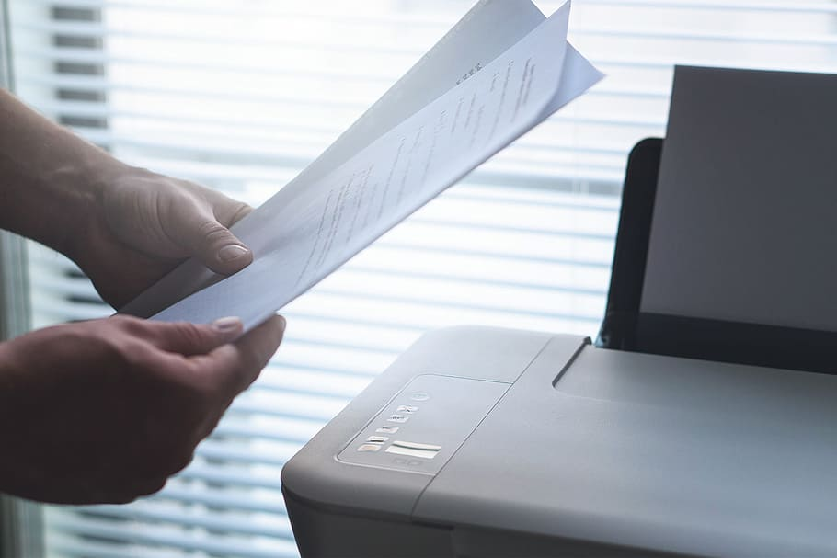
Enrolling Legal Spouse
SPOUSE ELIGIBILITY REQUIREMENTS
Key Notes:
Retirees are able to add their legal spouse and child/children with suppling the supporting documents.
Employee and spouse must be married one year prior
to retirement date.
  Documentation required
    Marriage Certificate
    Birth Certificate for spouse and child(ren)
    Social Security Cards for spouse and child(ren)
    First Page of Federal Tax Form 1040 with financial information redacted/masked to add a spouse/partner*

Slide 4

RAIL UNION RETIREMENT BENEFITS
All Rail Union employees eligible are entitled to participate in the following plans with NJT:
Retirement Major Medical/Rx Plan:
  Horizon Blue Cross Blue Shield DA10 Health Care Plan
  Prescription coverage administered by Express Scripts
      For eligible spouses and dependents.
  Life Insurance
  The Hartford Insurance Plan
      For retiree only
Enrollment in Medicare Parts A and B is required for retirees and/or their dependents on disability who are eligible for Railroad retirement.

Slide 5
TRANSFERABLE BENEFITS
ACTIVE BENEFITS WILL TRANSFER AS FOLLOWS:
COVERAGE | ACTION | EFFECTIVE DATE
Medical | Transfer to Retiree Medical Group | End of the month following the month in which retirement occurs.
Prescription Drug Card | Transfer to Retirement Prescription (Rx) Plan Group | End of the month following the month in which retirement occurs.
Supplemental Life | Reduction from $10,000.00 Transfer to Retiree amount $2,000.00 Free | End of the month following the month in which retirement occurs.

Slide 6
TERMINATED BENEFITS
BENEFITS WILL TERMINATE AS FOLLOWS:
COVERAGE | ACTION | EFFECTIVE DATE
Dental | Terminate | End of the month following the month in which retirement occurs.
Vision | Terminate | End of the month following the month in which retirement occurs.

Slide 7
Retirement Medical Plan Rates
Effective January 1, 2024 – RATES ARE SUBJECT TO CHANGE
MONTHLY RAIL UNION UNDER 65 RATES
UNDER 65
HORIZON DIRECT ACCESS PLAN (DA10) + RX
RATE
RETIREE SINGLE (60-65)
$0.00
SPOUSE/PARTNER AGED 60 & UNDER
$0.00
RETIREE & SPOUSE/PARTNER (60-65)
$0.00
DEPENDENTS UNDER AGE 26
$0.00

Slide 8

Conversion of Life Insurance
Hartford Life Insurance Company
PLAN
Conversion Available – Call (877) 320-0484 | May convert active Hartford Life Insurance policy within 90 days after retirement date: ($5,000.00, $8,000.00, $25,000.00 or $50,000.00)

Slide 9
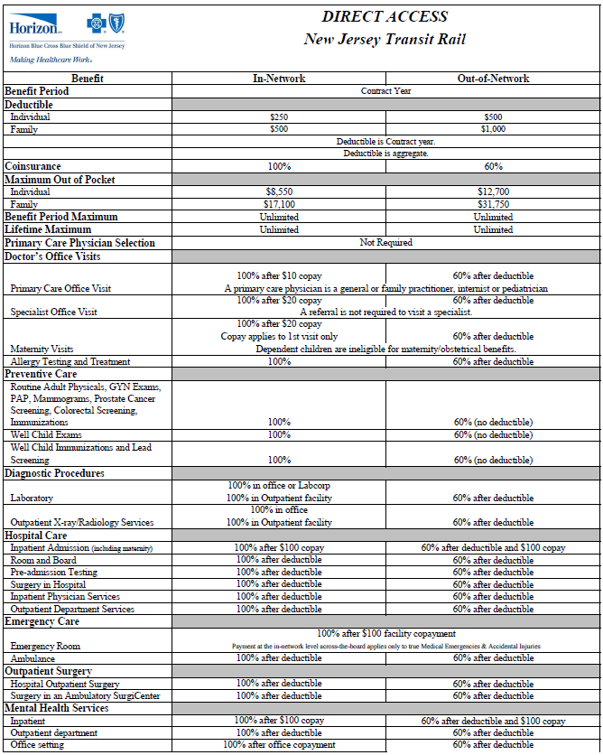


DIRECT ACCESS (DA 10) summaRY

Slide 10
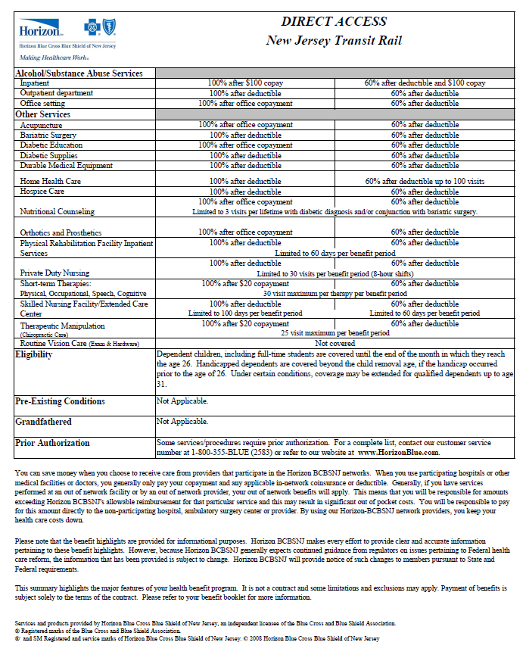


DIRECT ACCESS (DA 10)

Slide 11

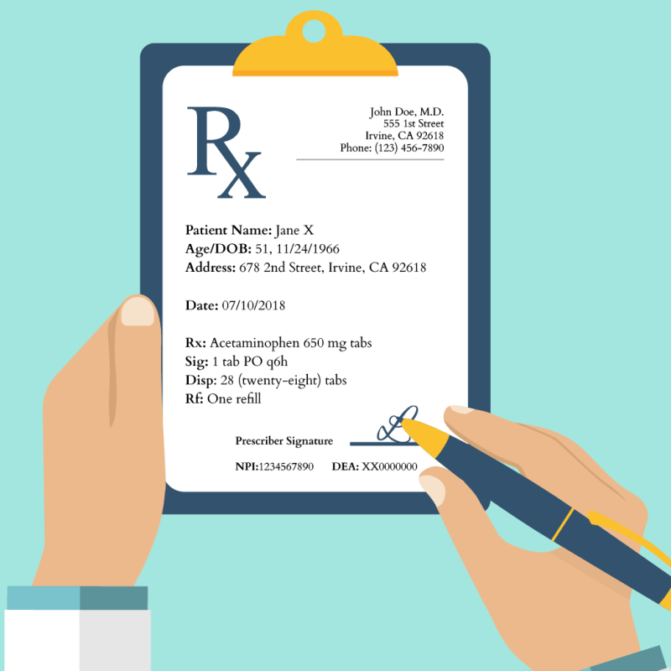
EXPRESS SCRIPTS PLAN REVIEW
You will receive a separate ID card from ESI once enrolled
There is a mandatory mail order for all maintenance drugs – 1st two fills at the pharmacy then mail order
Mail Order for Maintenance Drugs
  90-day supply
  Generic 0% co-pay
  Brand name 20%, 30% co-pay where Generic available
  $35.00 Maximum
Retail Pharmacy
  Generic 10% co-pay
  Brand Name 20%, 30% co-pay where Generic available
  $35.00 Maximum
  34-day supply or 100 units

Slide 12
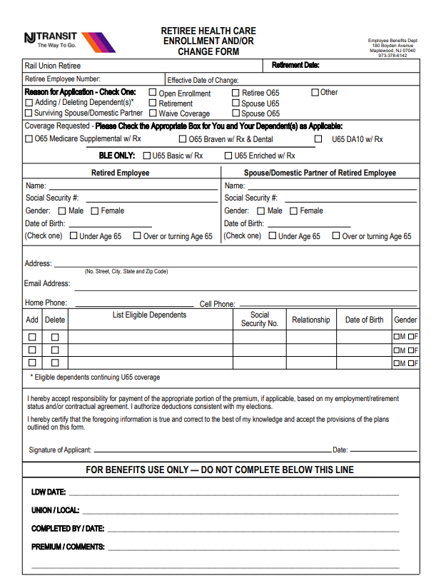
DA10 Enrollment Form
Reason for application
Select the box that applies to you/dependent
Employee personal information
Spouse personal information
If you would like to add a dependent, fill out this portion and provide all supporting documentation.
Sign and Date

Slide 13
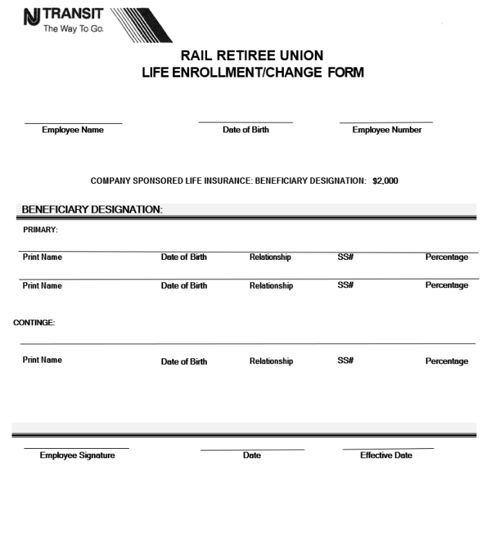
Life Insurance Enrollment Form
Employee name,
D.O.B., and Emp.
number
List your
beneficiaries
for free
$2000.00
Sign and Date

Slide 14
Congrats on your Retirement!!
Here are some
Important Phone Numbers
Contact | Phone | Email & Website
Shonta Thomas Assistant Manager Rail Retiree Benefits | P: 973-378-6035 F: 201-992-9307 | SRThomas@njtransit.com
Horizon BCBSNJ Member Services Medical | 877-241-8414 | www.horizonblue.com/njtransit
Express Scripts Member Services | 877-796-9759 | www.express-scripts.com
The Hartford | 877 320-0484 | www.thehartford.com
t

